Slide 1
Music Recommender System
Shardul Dhekane & Shreya Tripathi

Slide 2


Overview
Problem
Approach
Data anaLYsis
The topic of the Problem
Methodology of
Recommender System
Readings from the Data and Preprocessing
Workflow
Error
Workflow of the Project
Calculation of Error and Accuracy

Slide 3



problem
enhance user experience by providing personalized music recommendations
Combine and process data from multiple sources,
to create a comprehensive dataset for recommendations
Preference Based Algorithms
Implement mechanisms to provide real-time recommendations that adapt to changing user preferences and behaviors.

Slide 4


Problem
In the vast and ever-expanding world of digital music, listeners are overwhelmed by the sheer volume of available tracks. With millions of songs across various genres and subgenres, finding music that aligns with individual tastes and preferences is a daunting task. Traditional methods of music discovery, such as radio or curated playlists, often fall short in providing personalized recommendations that cater to the unique auditory preferences of each listener.
The primary goal of the Music Recommender System is to enhance user experience by providing personalized music recommendations. The system should leverage available data to suggest tracks that align with user preferences, thereby increasing user engagement and satisfaction.

Slide 5
Approach
Using hybrid filtering
Features Based Content Filtering
Description Based Content Filtering
User Based Collaborative Filtering

Slide 6
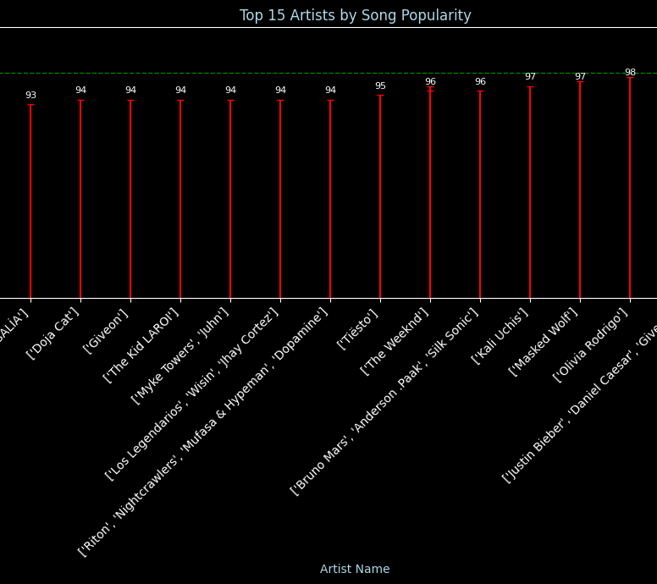
Data analysis
Using Dataset consisting of 600K Songs from Year 1990-2021
Exploring the dataset and cleaning the problems like missing data and duplicates
We can visualize many interesting points from the dataset

Slide 7
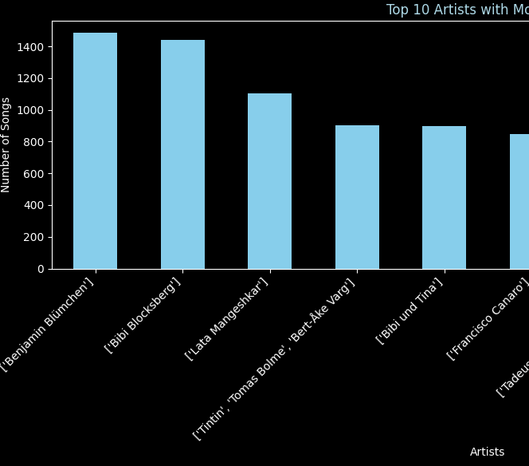
Data analysis
Did you know the famous Artist Lata Mangeshkar has Over 1000 Songs?

Slide 8
Workflow
Data Gathering
Model Training
Deployment using Streamlit
Preprocessing and Synthetic Creation
Model Testing
Principles of efficient design

Slide 9




Error
Humara model accurate hai
ACCURACY:
F1 Score:
RECALL:

Slide 10
Overview of hybrid filtering model
Popularity Based Filtering:
Popularity-based filtering is a straightforward recommendation approach that suggests items based on their popularity.
Features Based Filtering:
Features-based filtering, also known as content-based filtering, is a recommendation approach that suggests items to users based on the features of the items themselves.
Tags and Description Based Filtering:
This type of filtering is also a content-based filtering, is a recommendation approach that suggests items to users based on description and similarity of songs.
Collaborative Based Filtering:
Collaborative-based filtering is a user-based filtering where the recommendations are based on Near Similar Rated User

Slide 11

Thank you
Shardul Dhekane & Shreya Tripathi

